Slide 1
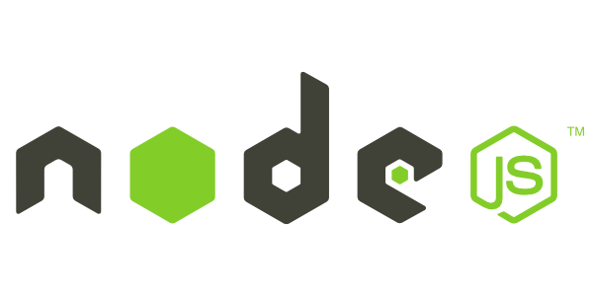
Introduction to Node.js
Frank Walsh
Diarmuid O'Connor

Slide 2
Agenda

Slide 3
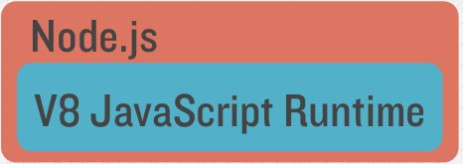
What's Node.js
High-performance server-side JavaScript
Used to build scalable networked services and applications.
Uses the Google Chrome V8 just-in-time compilation to Machine code
Fast because V8 is mostly C.
Well designed module system for third party code (i.e. Node Packet Manage, NPM)

Slide 4
What's Node: V8 engine
Embeddable C++ component
in the lab you (may have) needed to install C++
Can expose C++ objects to Javascript
Very fast and multi-platform
Find out a bit about it's history here:
http://www.google.com/googlebooks/chrome/big_12.html

Slide 5
What's Node.js: Event-based
Generally, input/output (io) is slow.
Reading/writing to data store, probably across a network.
Calculations in cpu are fast.
2+2=4
Most time in programs spent waiting for io to complete.
In applications with lots of concurrent users (e.g. web servers), you can't stop everything and wait for io to complete.
Solutions to deal with this are:
Blocking code with multiple threads of execution (e.g. Apache, IIS)
Non-blocking, event-based code in single thread (e.g. NGINX, Node.js)

Slide 6
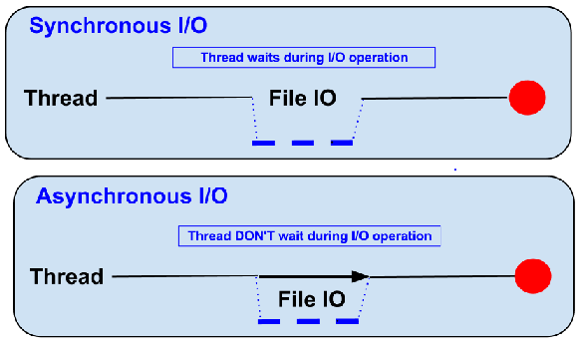
Blocking (Traditional)
Traditional code waits for input before proceeding (Synchronous)
The thread on a server "blocks" on io and resumes when it returns.

Slide 7
Non-blocking (Node)
Node.js code runs in a Non-blocking, event-based Javascript thread
No overhead associated with threads
Good for high concurrency (i.e. lots of client requests at the same time)

Slide 8
Blocking/Non-blocking Example
Blocking
Read from file and set equal to contents
Print Contents
Do Something Else...
Non-blocking
Read from File
Whenever read is complete, print contents
Do Something Else...

Slide 9
Blocking/Non-blocking Example
Blocking
var contents = fs.readFileSync('/etc/hosts');
console.log(contents);
console.log('Doing something else');
Non-blocking
fs.readFile('/etc/hosts', function(err, contents) {
console.log(contents);
});
console.log('Doing something else');

Slide 10
Blocking vs. Non-blocking
Threads consume resources
Memory on stack
Processing time for context switching etc.
No thread management on single threaded apps
Just execute “callbacks” when event occurs
Callbacks are usually in the form of anonamous functions.

Slide 11
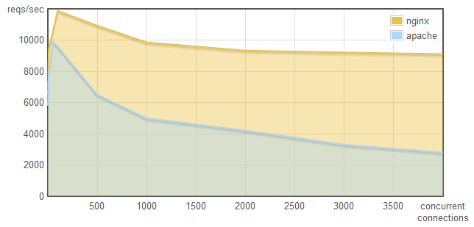
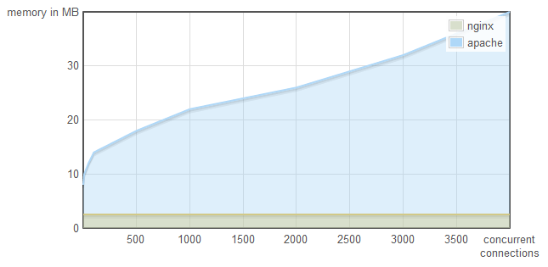
Why does it matter...
This is why:
http://blog.webfaction.com/a-little-holiday-present

Slide 12
Node.js Event Loop
var http = require('http');
var server = http.createServer(function (request, response) {
response.writeHead(200, {"Content-Type": "text/plain"});
response.end("Hello World\n");
});
server.listen(8080);
console.log("Server running at http://127.0.0.1:8080/");
Callback
EVENT LOOP STARTS WHEN FINISHED
Event Queue
Known Events
request
request
request

Slide 13
Callbacks
“request” callback
Example of 2 callbacks
var http = require('http');
var server = http.createServer(function(request, response) {
response.writeHead(200);
response.write("Hello!");
setTimeout(function(){
response.write("Good Bye!");
response.end();
}, 5000);
});
server.listen(8080);
“timeout” callback

Slide 14
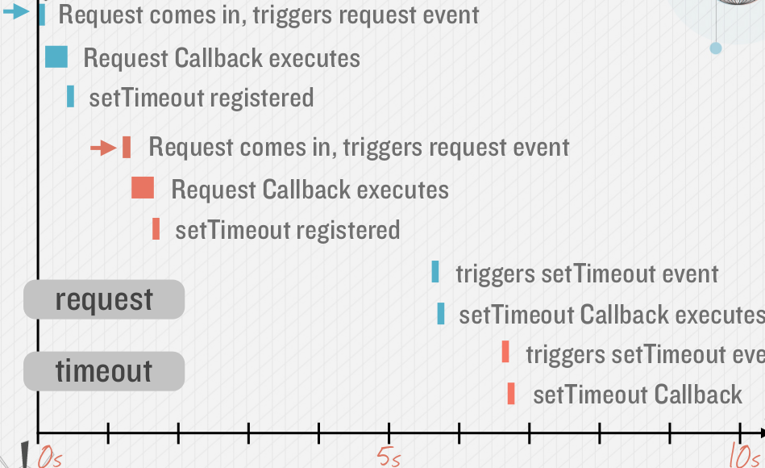
Callback Timeline, Non Blocking

Slide 15
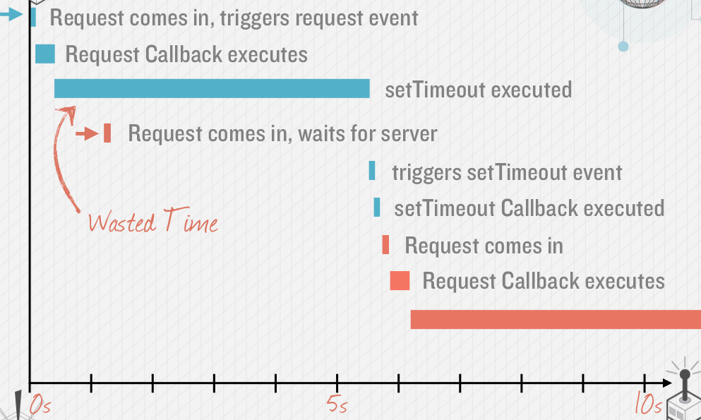
Callback Timeline, Blocking

Slide 16
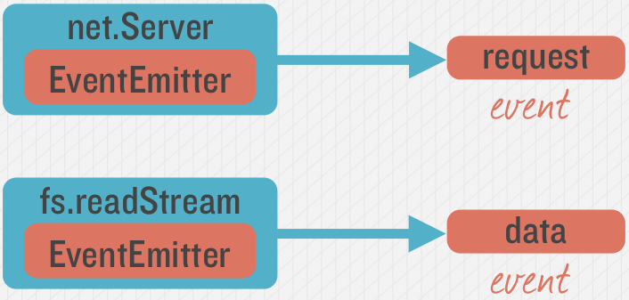
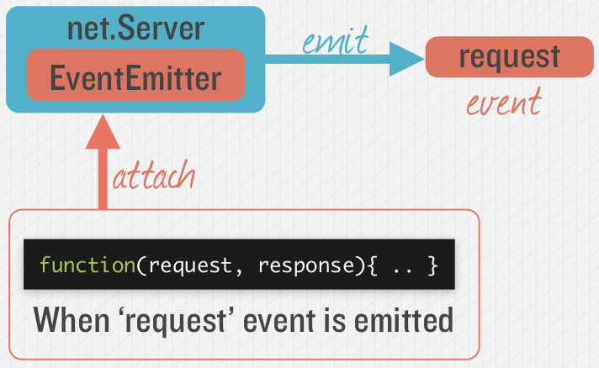
Emitting Event in Node
Many objects can emit events in node.
See here for a description of how HTTP Server works

Slide 17
Node Modules

Slide 18

Node Modules
Node has a small core API
Most applications depend on 3rd party modules
3rd party modules curated in online registry called the Node Package Manager system (NPM)
NPM downloads and installs modules, placing them into a node_modules folder in your current folder.

Slide 19
Node Modules
Installing a NPM Module is easy:
Navigate to the application folder and run:
npm install express
This installs into a “node_module” folder in the current folder.
To use the module in your code, use:
var express = require('express');
This loads express from local node_modules folder.

Slide 20
Global Node Modules
Sometimes you may want to access modules from the shell/command line.
You can install modules that will execute glovbaly by including the '-g'.
Example, Grunt is a Node-based software management/build tool for Javascript.
npm install -g grunt-cli
This puts the “grunt” command in the system path, allowing it to be run from any directory.

Slide 21
Creating your own Node Modules
We want to create the following module called custom_hello.js:
var hello = function() {
console.log("hello!");
} exports = hello;
To access in our application, app.js:
var hello = require('./custom_hello'); hello();
Export defines what
require returns

Slide 22
Creating your own Node Modules
Another example custom_goodbye.js:
exports.goodbye = function() {
console.log("Bye!");
}
To access in our application, app.js:
var gb = require('./custom_goodbye'); gb.goodbye();
Export defines what
require returns

Slide 23
Creating your own Node Modules
Export defines what
require returns
Exporting Multiple Functions, my_Module.js:
exports.hello = function() {
console.log("Hello!");
}
exports.goodbye = function() {
console.log("Bye!");
}
To access in our application, app.js:
var myMod = require('./my_Module.js'); myMod.hello(); myMod.goodbye();

Slide 24
The require search
Require searches for modules based on path specified:
var myMod = require('./myModule') //current dir
var myMod = require('../myModule') //parent dir
var myMod = require('../modules/myModule')
Just providing the module name will search in node_modules folder
var myMod = require('myModule')

Slide 25
The Express Package

Slide 26
What is Express?
Web application framework for
Based on “Sinatra” is a DSL for quickly creating web applications in Ruby with minimal effort. http://www.sinatrarb.com/intro.html
Built on the Connect middleware package
It's popular because it's
Minimalist,
Fast
Simple

Slide 27
What Express Gives Us...
Parses arguments and headers
Easy Routing
Route a URL to a Javascript callback function
Views
Partials
Layouts
Environment-based Configuration
Sessions
File Uploads

Slide 28
Simple Express App (server.js)
Loads Express module
var express = require('express');
var app = express()
// allow serving of static files from the public directory
app.use(express.static(__dirname + '/public'));
var server = app.listen(3000, function () {
var host = server.address().address
var port = server.address().port
console.log('Example app listening at http://%s:%s', host, port)
})
Instantiates Express server
Root route for HTTP GET
Listen on on port 3000

Slide 29
Getting Started with Express
Installing Express
[local install] C:\> npm install express
[global install] C:\> npm install express -g

Slide 30
Express Configuration
Express allows you to easily configure your web app behaviour...
// allow serving of static files from the public directory
app.use(express.static(__dirname + '/public'));
// configure to parse application/json
app.use(bodyParser.json());
// configure to parse application/x-www-form-urlencoded
app.use(bodyParser.urlencoded({ extended: true }));

Slide 31
Routing Examples
//Catch-all
app.all('/app(/*)?', requiresLogin);
// Routes
app.get('/', routes.index);
app.get('/about', routes.about);
app.get('/contact', routes.contact);
app.get('/app/list', routes.listapps);
app.get('/app/new', routes.newapp);
app.post('/app/new', routes.saveapp);
app.get('/app/:app', routes.getapp);
app.get('/app/:app/edit', routes.editapp);
Catch-all – works for all HTTP verbs
HTTP GET request
HTTP POST request
Accepts :app route argument
Syntax follows the pattern:
App.[verb](path, function(req,res), [function(req,res)]);

Slide 32
Node Applications Structure

Slide 33
Structuring Node Apps
Node Server Code needs to be structured
Manage code base
Keeps code maintainable
Nodes packaging system supports this approach
Typical Node.js application code:
main server code
api implementation code
helper code

Slide 34
Example Approach:
Use a “project root” folder is the top level and contains the “entry point” or main server code
Always run npm in this folder to ensure just one node_modules folder
Use a public folder within the node folder for your

Slide 35
Suggested Project Structure
Root of your actual application
/projectroot/
package.json
readme.md
server.js
public/
/images
/stylesheets
/scripts
index.html
node_modules/
routes/
Tells Node and NPM what packages are required
The main entry point for the Express application
Static content
Directory for unit tests
Output directory for all NPM installations

